Slide 1
DevOps: Cloud Native Operations
Philosophy & Practices

Slide 2
SPEED

Slide 3
Agenda
Context
What has changed that dictates doing things differently?
Philosophy
What do elite DevOps do that other teams do not?
Categories of Tooling
What they are and how they integrate to form pipelines?
Best Practices
Principles that enable better DevOps performance
Roles
Who does what?

Slide 4
Context
What has changed that dictates doing things differently?

Slide 5
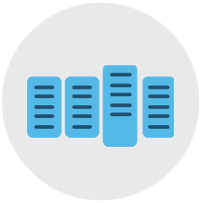
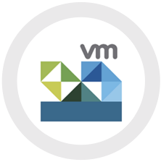
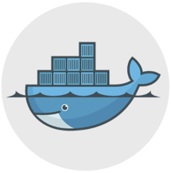
Physical Servers
(Months)
Virtual Machines
(Minutes)
Containers
(Seconds)
Compute Unit
(time to create)

Slide 6


Physical Servers
(Months)
Virtual Machines
(Minutes)
Containers
(Seconds)
Compute Unit
(time to create)
Application Architecture
Pets/Mode 1/Monoliths
Cattle/Mode 2/Microservices

Slide 7
Physical Servers
(Months)
Virtual Machines
(Minutes)
Containers
(Seconds)
Compute Unit
(time to create)
Application Architecture
Pets/Mode 1/Monoliths
Cattle/Mode 2/Microservices
Compute Scarcity
High
Component Coupling
Fun
Facts
Compute Scarcity
Low
Component Coupling

Slide 8
Physical Servers
(Months)
Virtual Machines
(Minutes)
Containers
(Seconds)
Compute Unit
(time to create)
Application Architecture
Pets/Mode 1/Monoliths
Cattle/Mode 2/Microservices
Compute Scarcity
Release Frequency
High
Component Coupling
Level of Automation
Fun
Facts
Release Frequency
Compute Scarcity
Low
Level of Automation
Component Coupling

Slide 9
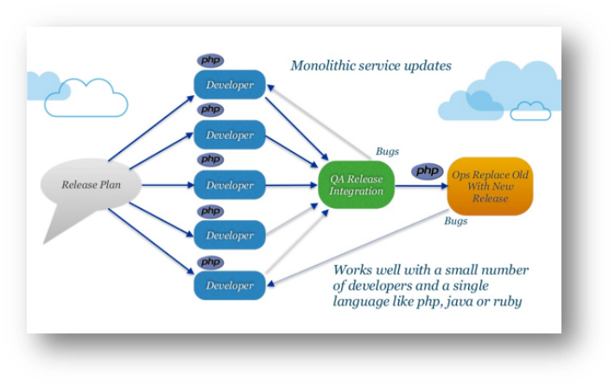
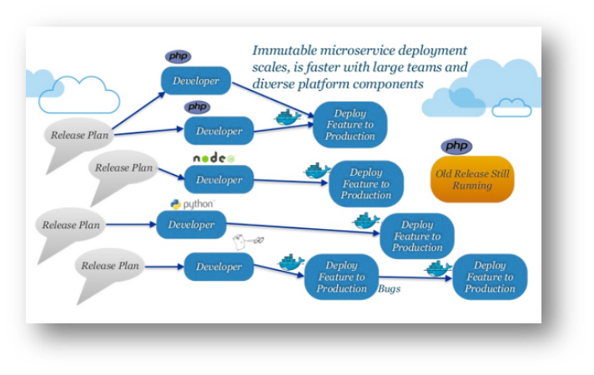
Monoliths vs Microservices
Pets/Mode 1/Monoliths
Cattle/Mode 2/Microservices

Slide 10
Some Takeaways
This DOESN’T mean:
You have to use containers or microservices to take advantage of automation and DevOps
You have to automate everything all at once
You can’t gain automation and DevOps benefits if you’re using VMs as opposed to containers
Every organization’s journey is incremental, helpful to understand what the goals are

Slide 11
Philosophy
What do elite DevOps teams do that others do not?

Slide 12
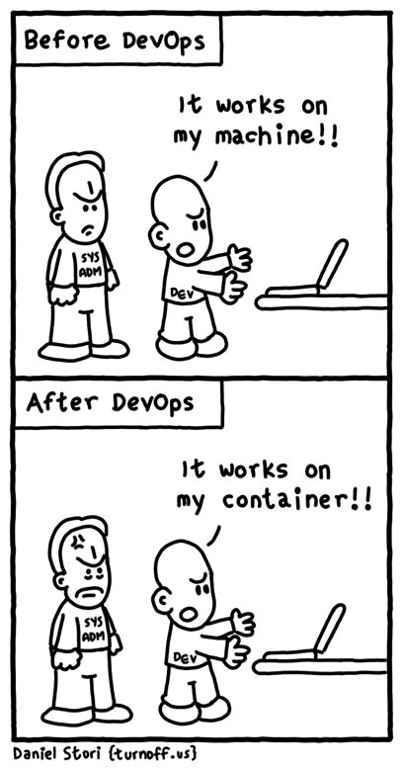
DevOps - What is it?
DevOps is a software development methodology that combines software development (Dev) with information technology operations (Ops).
The goal of DevOps is to shorten the systems development life cycle while also delivering features, fixes, and updates frequently in close alignment with business objectives.
The DevOps approach is to include automation and event monitoring at all steps of the software build

Slide 13
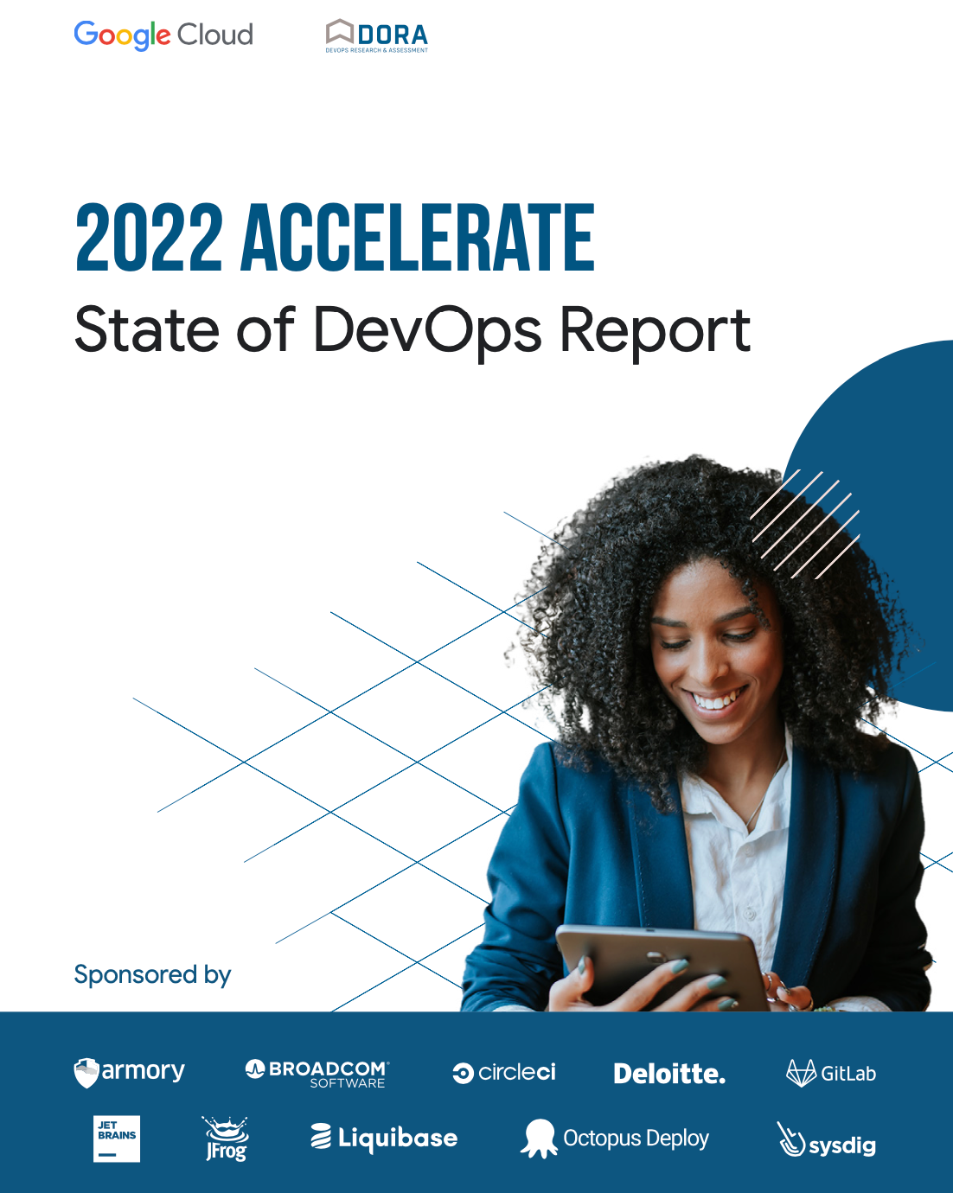
State of DevOps
8 years of research
33,000 professionals surveyed worldwide
Latest update: September 28, 2022
https://cloud.google.com/devops/state-of-devops/

Slide 14
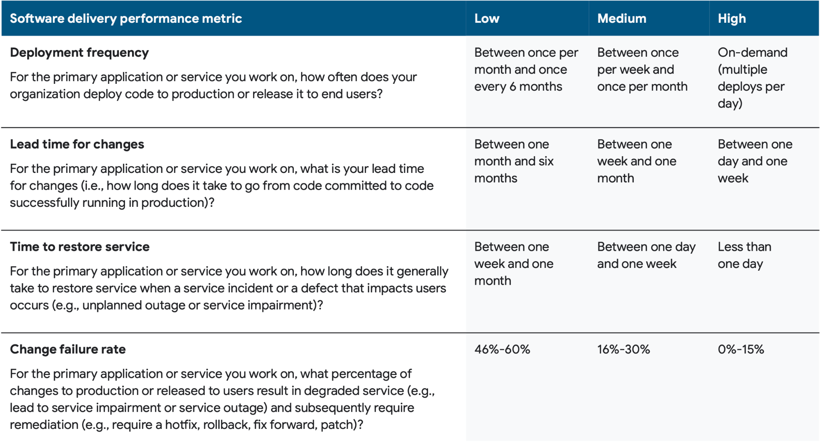
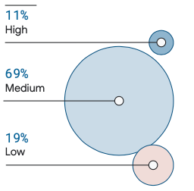
Defining Productivity Tiers

Slide 15
Advantages of DevOps
Speeding time to market
Automation
Removing barriers between development and deployment
Improving performance incrementally
Constant stream of incremental releases
Small changes have smaller risk footprint
Enhancing operational efficiencies
Improving the efficiency of the development, testing, and deployment process
Shared responsibilities reduce strain on one team
Making the complex simple
Employing a microservices model as part of the DevOps process allows development teams to create more responsive updates

Slide 16
DevOps Unknowns
Uncontrolled test suite growth
Cover what is relevant
Remove obsolete testing
Automating next generation digital interfaces slows releases
Capabilities like FaceID, augmented reality, etc. can lack tooling to automate testing
Continuous changes in the DevOps tool stack ecosystem
The open source landscape and commercial market are undergoing constant changes
Teams need to be aware of these changes and find ways to mature existing tools

Slide 17
Categories of Tooling
What are they and how do they integrate to form pipelines?

Slide 18
Virtualized Resources
Infrastructure-as-Code

Slide 19


Virtualized Resources
Resource Pipeline
I
Git-based
Source Code Control
Continuous Integration
Infrastructure-as-Code
Env
Deploy
Smoke Tests
Other

Slide 20



Virtualized Resources
Resource Pipeline
I
Git-based
Source Code Control
Continuous Integration
Notification Targets
OR
Infrastructure-as-Code
Email
Chat
Other
Env
Deploy
Smoke Tests
Other

Slide 21
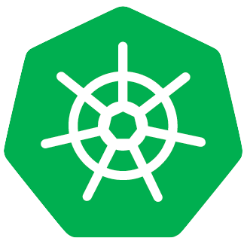
A
B
C
Virtualized Resources
Resource Pipeline
I
Git-based
Source Code Control
Continuous Integration
Notification Targets
OR
Infrastructure-as-Code
Email
Chat
Other
Env
Deploy
Smoke Tests
Other
A
B
C

Slide 22
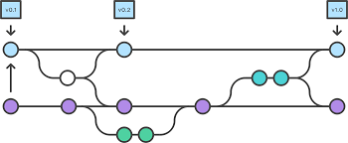
Build Pipeline
Git-based Source Code Control
Notification Targets
Email
Chat
Other
Fail
Customer Image
Registry
Container Image-based CI
App Images
Lint
Build
Scan
Test
Other
Pass
Virtualized Resources
Resource Pipeline
I
Git-based
Source Code Control
Continuous Integration
Notification Targets
OR
Infrastructure-as-Code
Email
Chat
Other
Env
Deploy
Smoke Tests
Smoke Tests
Other
A
B
C

Slide 23


Build Pipeline
Release Pipeline
Automated
Manual
Git-based Source Code Control
Notification Targets
Notification Targets
Email
Chat
Other
Email
Chat
Other
Fail
Customer Image
Registry
Container Image-based CI
Container Image-based CI
App Images
Env
Deploy
Integration
Tests
Load
Tests
Other
Lint
Build
Scan
Test
Other
PasS
Virtualized Resources
Resource Pipeline
I
Git-based
Source Code Control
Continuous Integration
Notification Targets
OR
Infrastructure-as-Code
Email
Chat
Other
Env
Deploy
Smoke Tests
Other
A
B
C

Slide 24
Best Practices
Principles that enable better DevOps performance

Slide 25
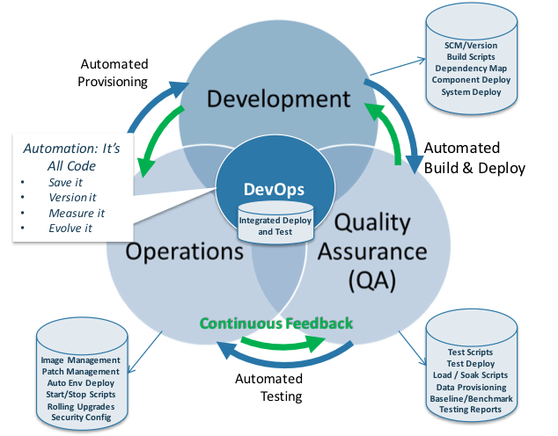
Best Practices
For better or worse, DevOps encompasses every aspect of a software system, including actual source code, infrastructure, configuration, data, testing, deployment, staging, production, and so forth.
Thus, finding and implementing the most widely accepted DevOps best practices can be a challenge, as there’s no absolutely “correct” technique. Instead, improving your teams’ DevOps practices is just as much about executing a philosophical shift as it is altering code or scripts in the system.
However there are ideals and common patterns to leverage as your template.

Slide 26
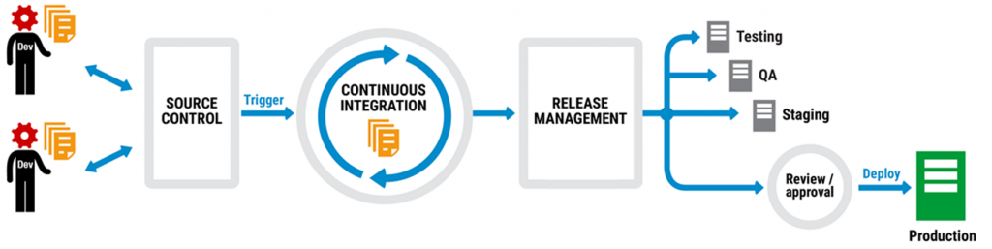
Version Control for All
A critical DevOps best practice is to version everything that is even remotely involved in the application. Everything from source code and configuration to infrastructure and the database should be version controlled.
This practice ensures that every aspect of the application, throughout the entire development life cycle, can be historically traced back through the single, ultimate origin that is the repository.
Any (adequately privileged) team member should be able to recreate a specific version of the complete application stack by issuing a single command.

Slide 27
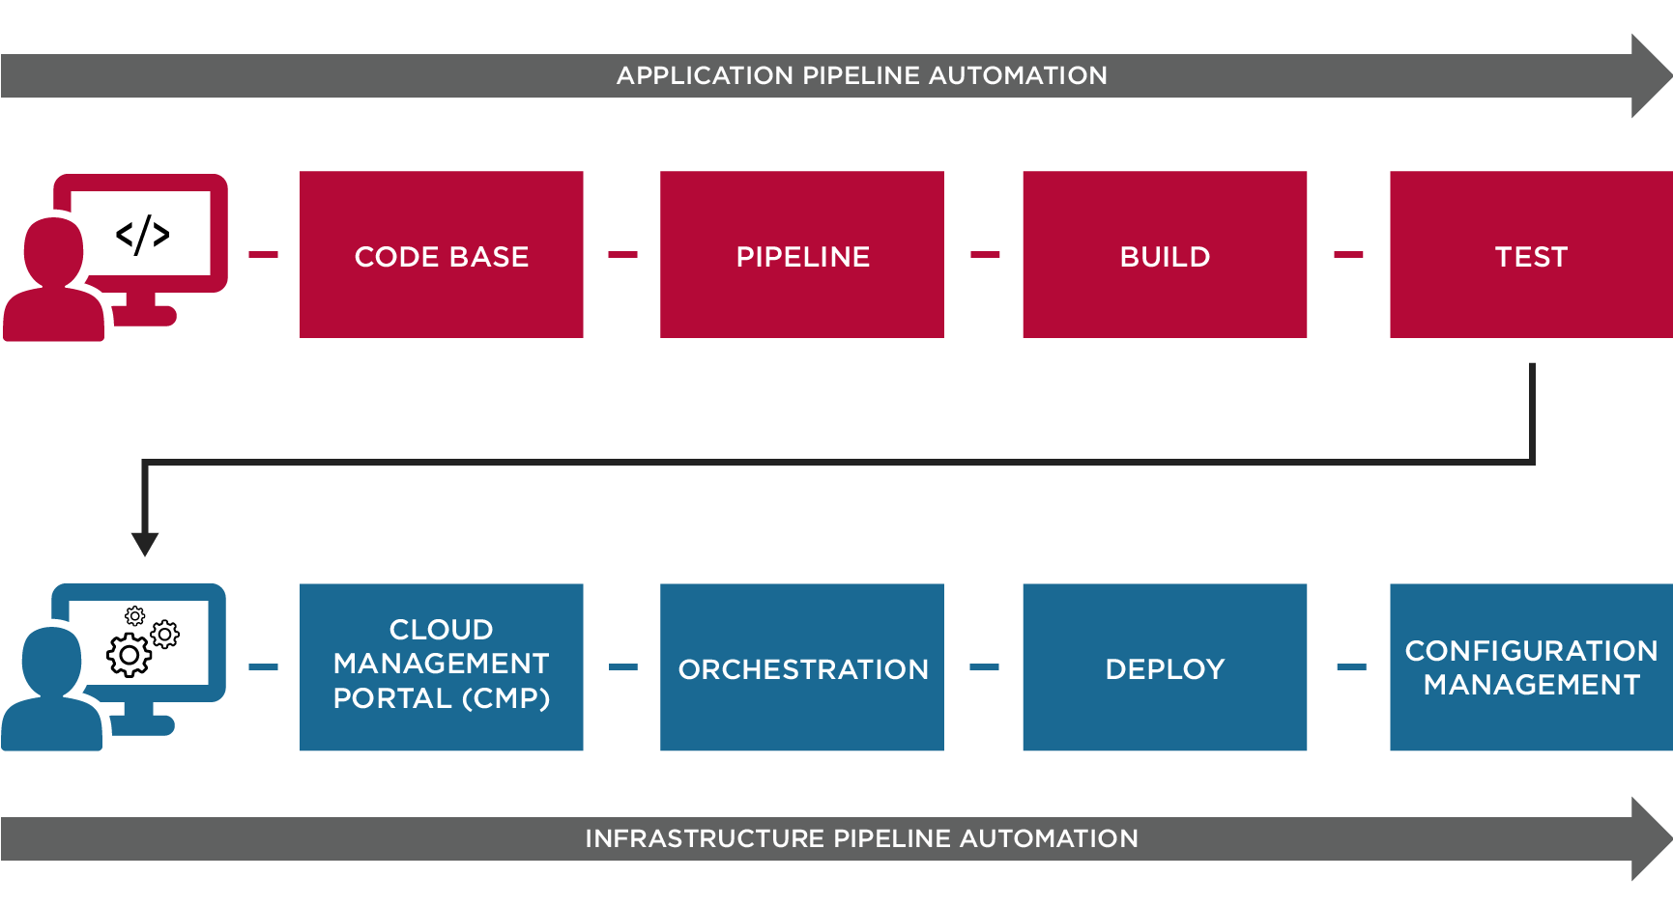
Automate Your Infrastructure
Implementing infrastructure as code practices revolves around the basic concept of infrastructure automation.
Creating scripts that can perform every step of infrastructure creation including server propagation, OS installation, configuration, etc…
Infrastructure configuration is no longer tied to a single machine or cluster, but can be copied and repeated ad nauseam, for as many nodes as needed.
Popular tools for IaC: Terraform, Ansible.
By explicitly defining every step in the process inside an IaC, multiple team members can alter and improve the process throughout the development life cycle, so the latest version is always the most robust and well-tested.

Slide 28
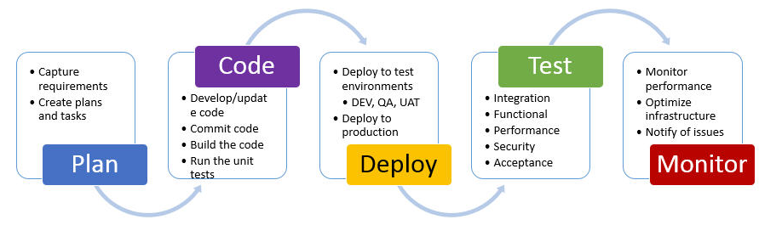
Deploy to Temporary Environments
Implement a policy of using temporary environments for everything, save perhaps the production environment itself.
Any given environment should only exist for a short period of time; typically long enough to execute the full suite of automated tests then destroyed — all without manual, human intervention.
Software is no longer tied to environments.
Since environments are frequently created and automatically destroyed after a matter of days, the infrastructure as code strengthens with every single addition or change to the scripts.

Slide 29
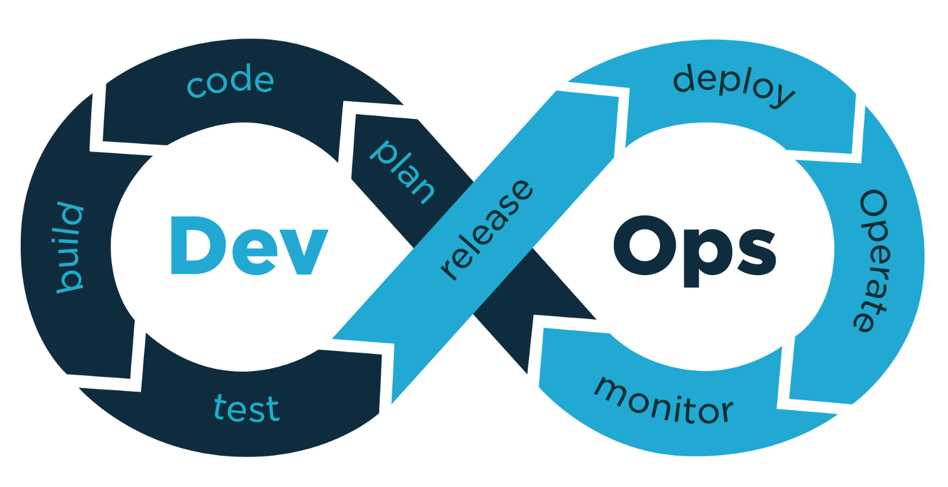
Implement Continuous Environment Testing
Automated environmental testing performs the steps and actions of an environment build without human intervention, verifying all components match expected parameters.
These tests need not be complicated, as they’re often checking simple parameters of the environment. It’s the combination of all these environmental tests that will provide you and your team with more robust DevOps best practices.

Slide 30
Roles
Who does what?

Slide 31
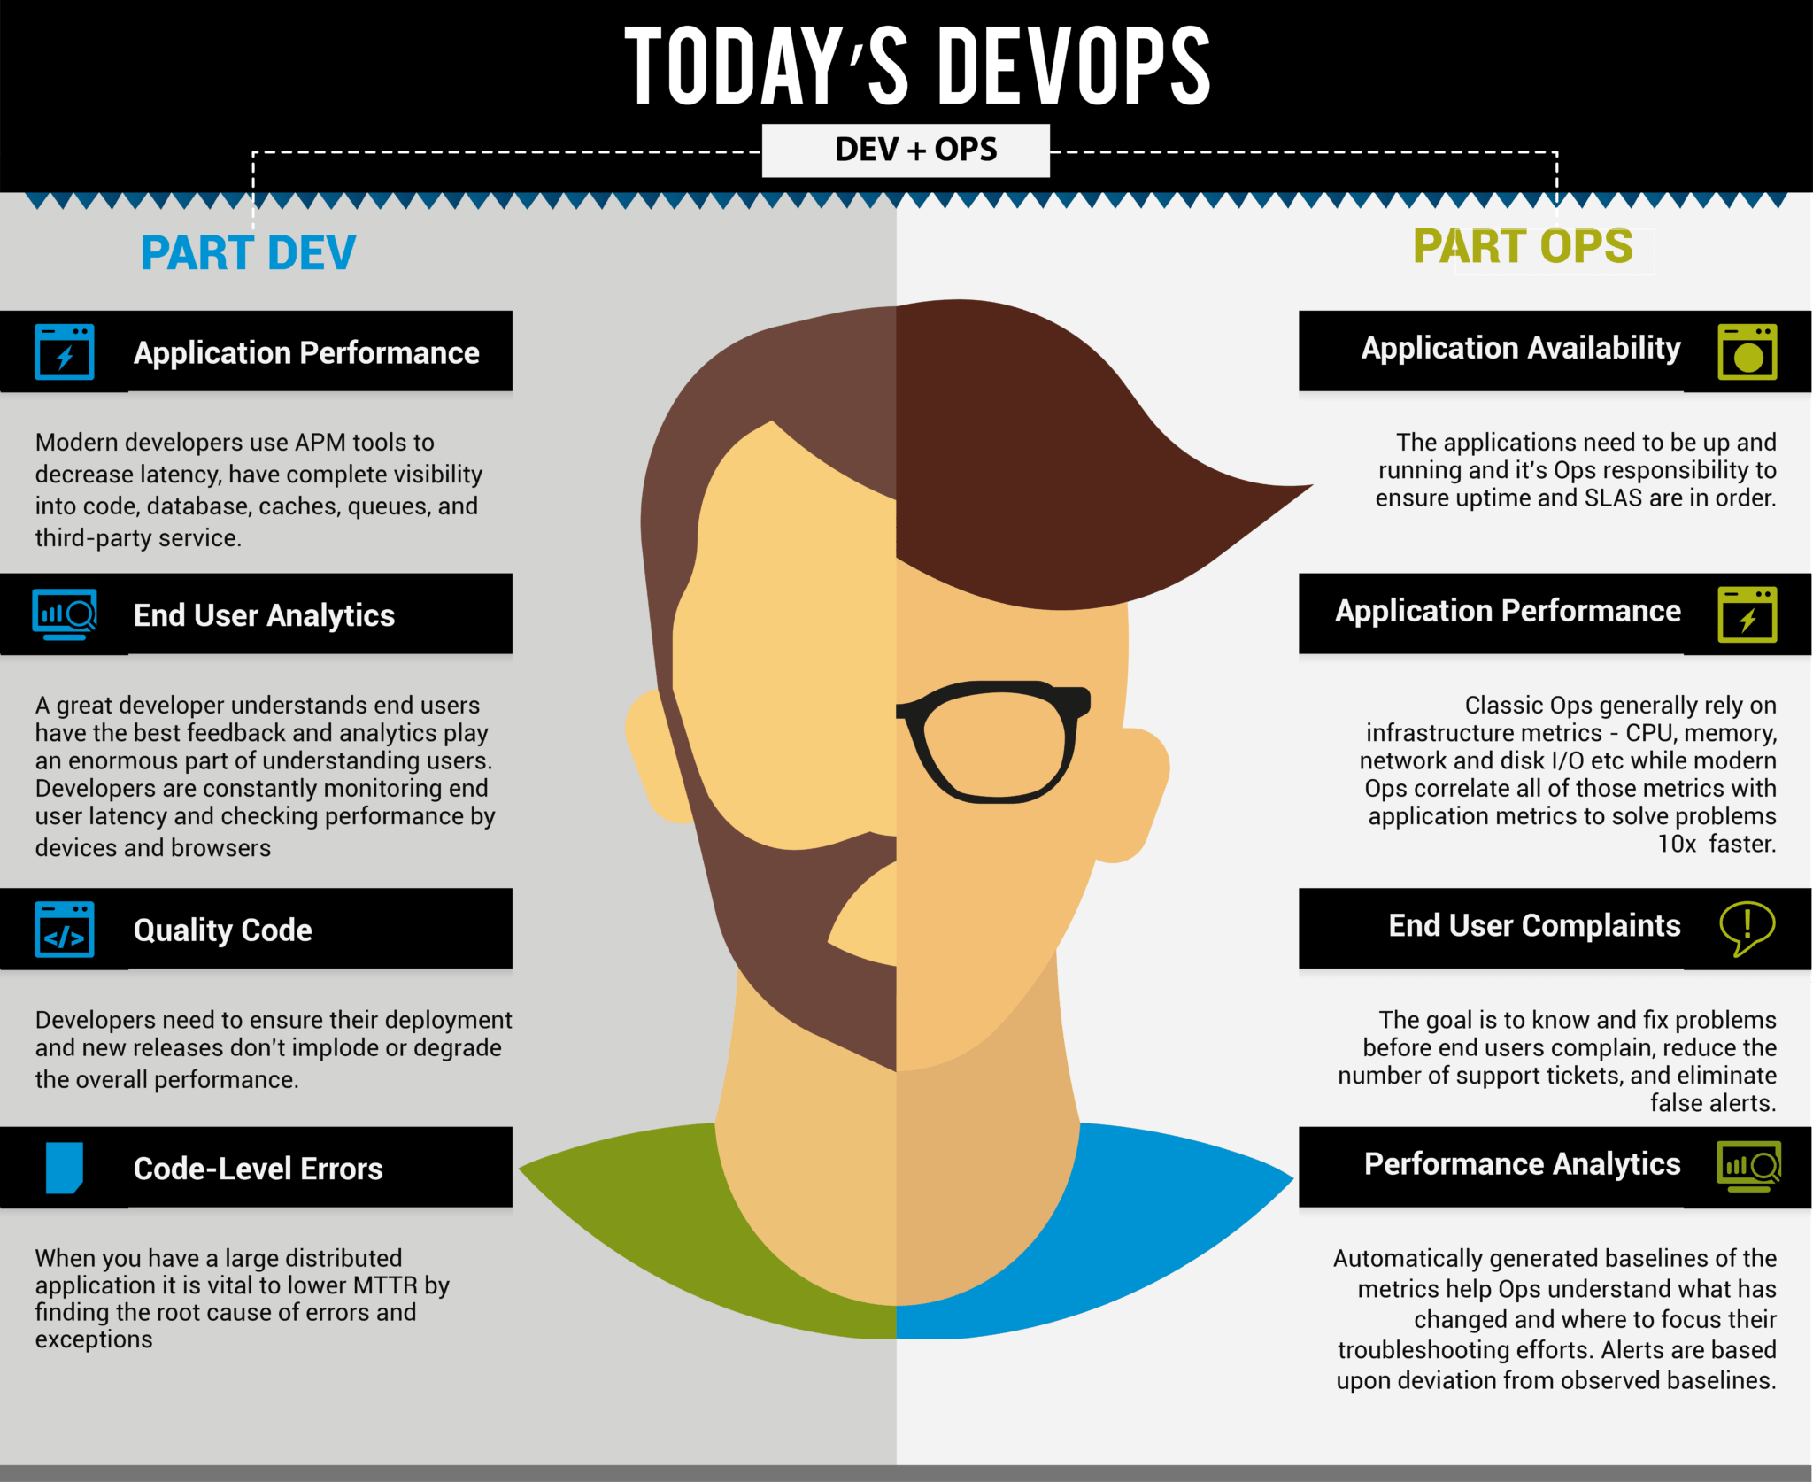

Slide 32
We have done this before . . .
Unified Communications - merging the phone specialist and the networking specialist.
Hyper Converged - HCI merges the server specialist, the networking specialist and the storage specialist.

Slide 33
DevOps: Three Primary Aspects
Do the tools I adopt…
… fit the infrastructure need?
… come with sufficient documentation and support?
… provide for an easy method to understand tool health ongoing?
TOOLS
Do my solutions and ops teams…
… communicate effectively, have feedback loops?
… share knowledge?
… train together?
… share a definition of operational health?
… have a shared calendar for both business- and IT-related events?
CULTURE
Are my automation efforts…
… sufficiently broad to properly reduce administrative excess?
… sufficiently narrow to avoid investing in areas that do not have ROI?
AUTOMATION

Slide 34
Process of Building a Culture of Agility
Phase 1
Phase 2
Phase 3
Phase 4
Phase 5
Phase 6
Forming the Team
Quick Wins
Leadership Support
Patterns And Reference Arch
Engage and Evangelize
Scale and Reorganize
Founded by key stakeholders within the organization covering the critical functional roles.
Delivering small but important projects successfully through the frameworks and guidance developed by the CoE.
Key leadership internally works closely with the CoE to deliver a shared organizational message.
Assists in developing and operationalizing the initial approved network and security architectures, patterns, cloud applications..
Works to develop an appropriate communications and evangelism strategy within the organization.
Adopt the use cases and success criteria provided throughout the community to leverage the resources developed.
‹#›

Slide 35
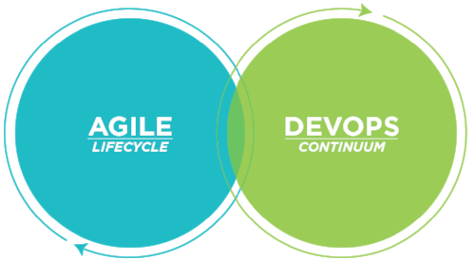
Agile and DevOps
Organize around business problem not technology
You build it, you own it!
Move decisions to Line of Business Product Owners
Remove dotted line roadblocks & ‘square’ communications

Slide 36
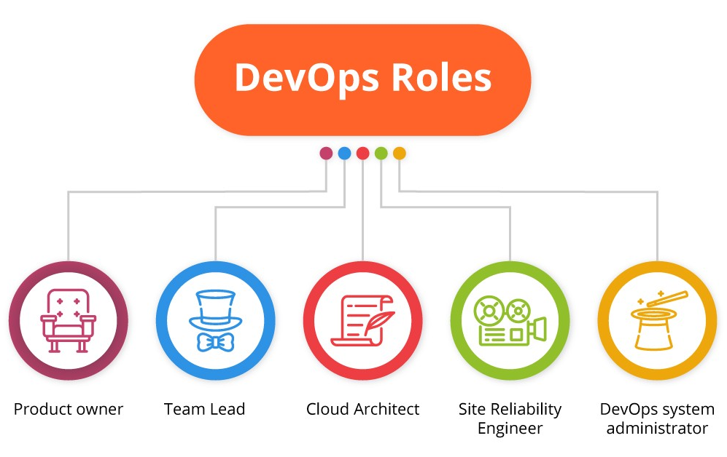
Product Owner The intersection between the team and the customer, the person that understands how the app should run to deliver value to the users.
Team Lead The most experienced team member, who can analyze the required skill set for each project and delegate the DevOps responsibilities across the team
Cloud Architect Ample hands-on experience with building cloud infrastructures
Site Reliability Engineer The specialist concentrated at ensuring stable performance and uninterrupted availability of high-load apps across large-scale systems.
DevOps Engineer Main DevOps Role - Cloud infrastructure & monitoring, support administrator, systems/cloud engineer.
DevOps is a culture, a set of practices, an approach to building the workflows to endorse collaboration between these departments — yet differentiation remains.
This is an example of a real-word DevOps team composition that allows to reach needed results and successfully launch products.

Slide 37
Summary

Slide 38
Summary
Context
What has changed that dictates doing things differently?
Philosophy
What do elite DevOps do that other teams do not?
Categories of Tooling
What they are and how they integrate to form pipelines?
Best Practices
Principles that enable better DevOps performance
Roles
Who does what?

